Slide 1
Organic food
Group 7

Slide 2
Group members
Phạm Anh Duy
Trần Khả Tú
Trần Ngọc Bảo Duy
Nguyễn Mạnh Tân
Chiếng Minh Sang

Slide 3
What does “organic” mean?

Slide 4
The term “organic” refers to the way agricultural products are grown and processed
Organic crops must be grown without the use of synthetic pesticides, bioengineered genes (GMOs), petroleum-based fertilizers, and sewage sludge-based fertilizers.

Slide 5
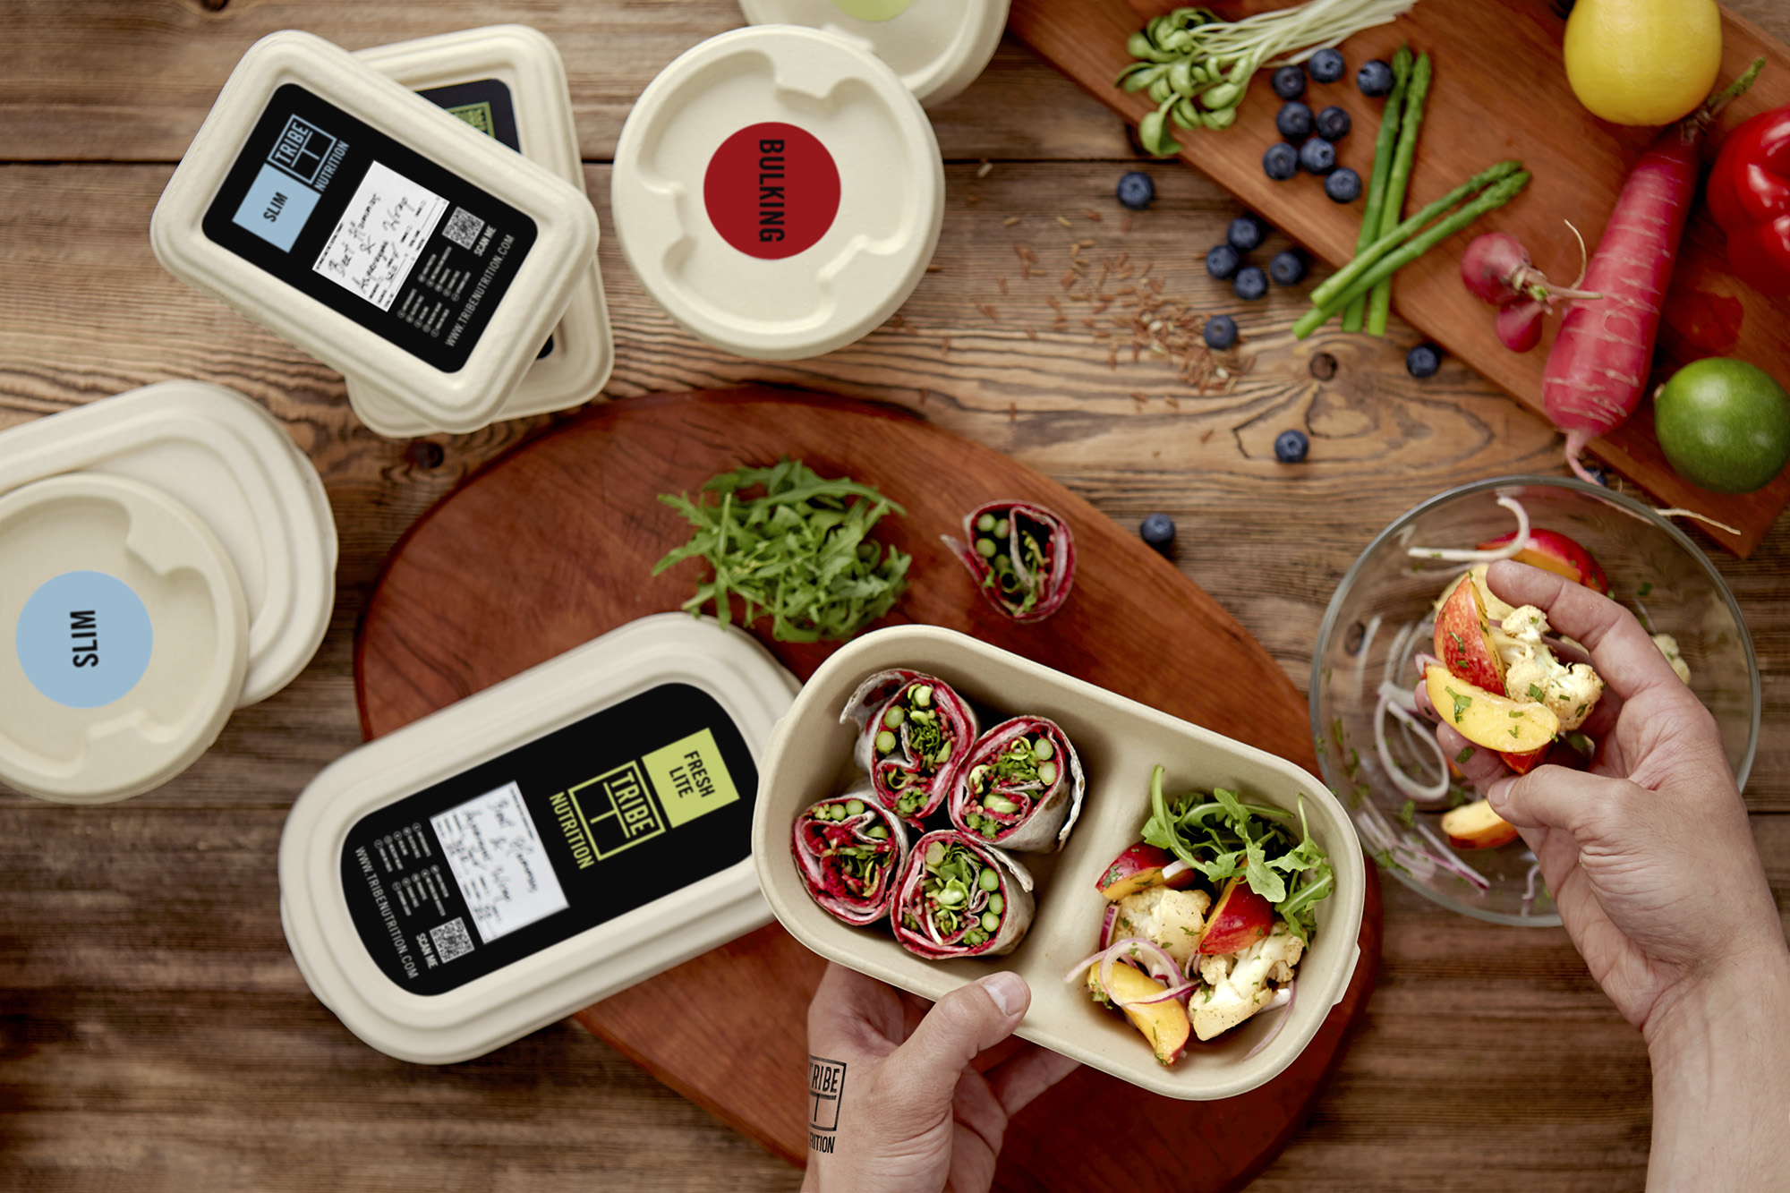
ORGANIC FOOD AND YOUR HEALTH

Slide 6
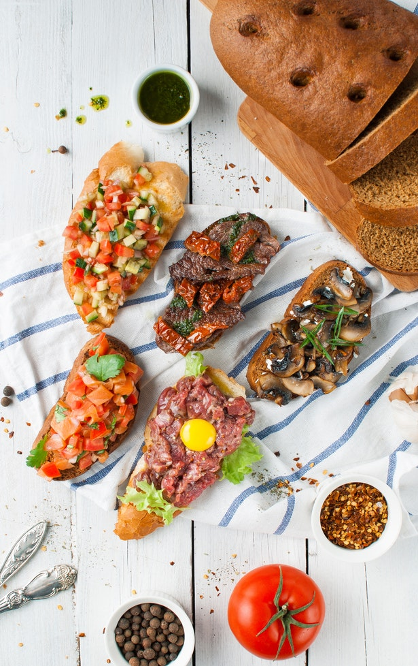
Nutrient-Denser Food
Stronger, More Energetic Body
It Tastes Better
It’s Cheaper

Slide 7


Slide 8
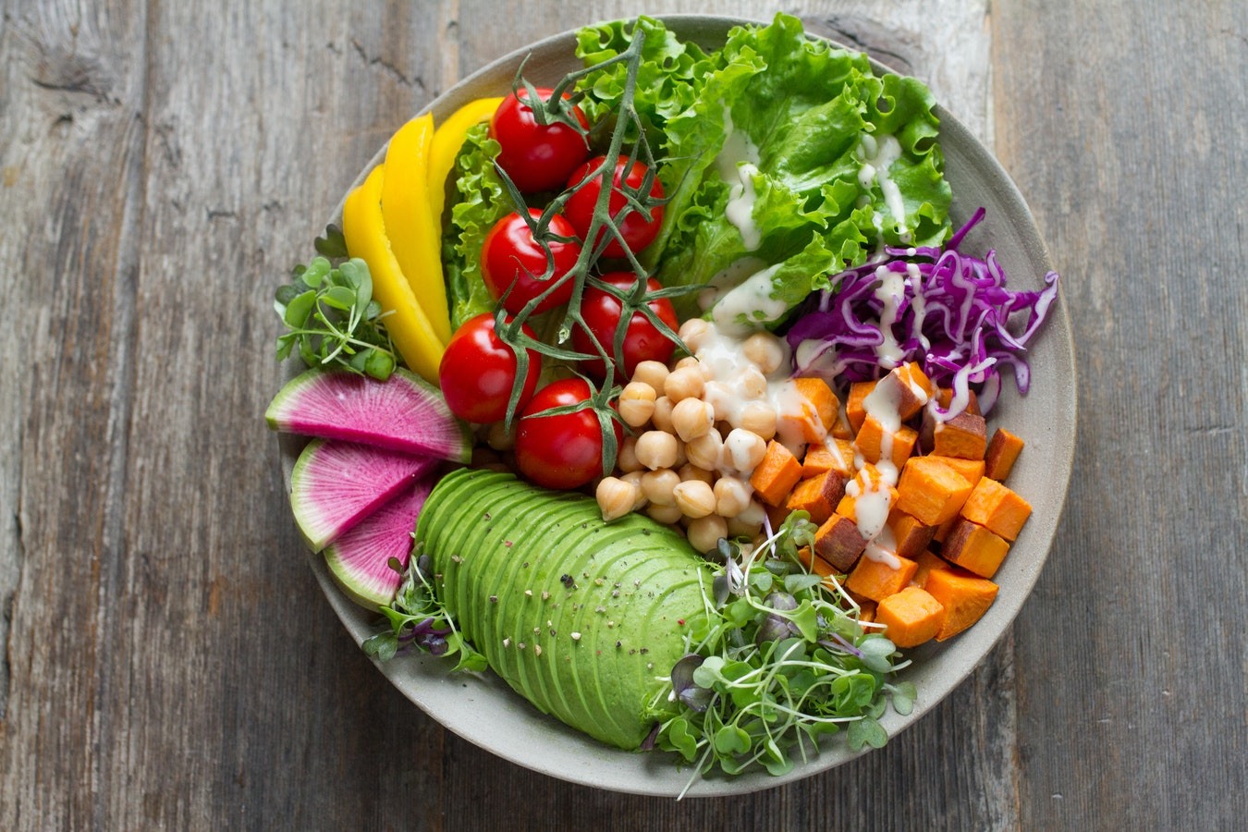
ORGANIC FOOD BENEFITS

Slide 9
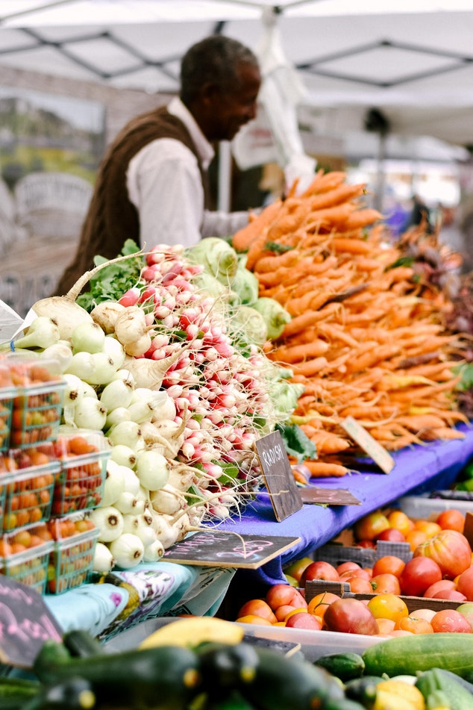
Supports the Local Economy
Keeps Our Families Healthy
Keeps Our Neighbors Healthy

Slide 10
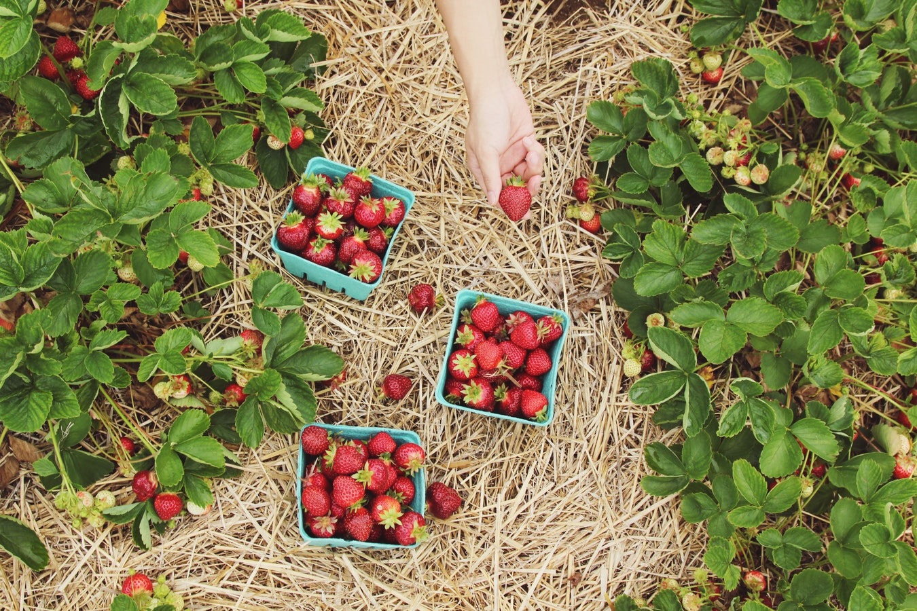
ORGANIC FOOD AND THE ENVIRONMENT

Slide 11
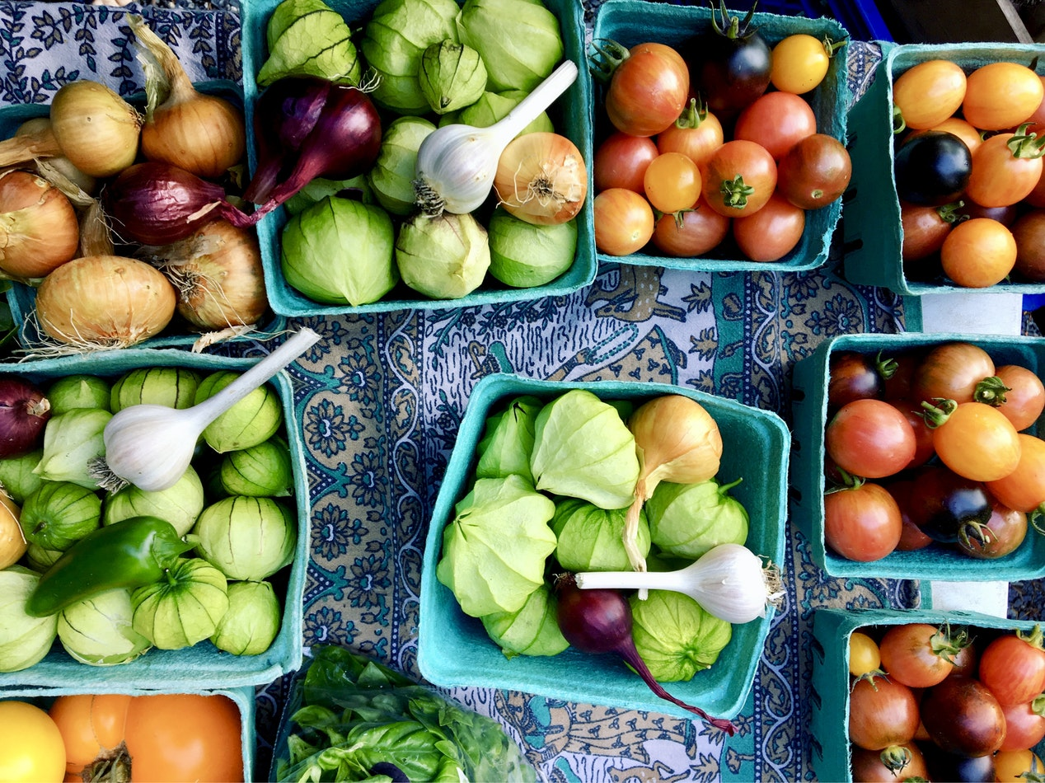
Keeps Plants Healthy
Keeps Animals Healthy
Creates Healthy Conditions
Supports and is Supported By Nature

Slide 12
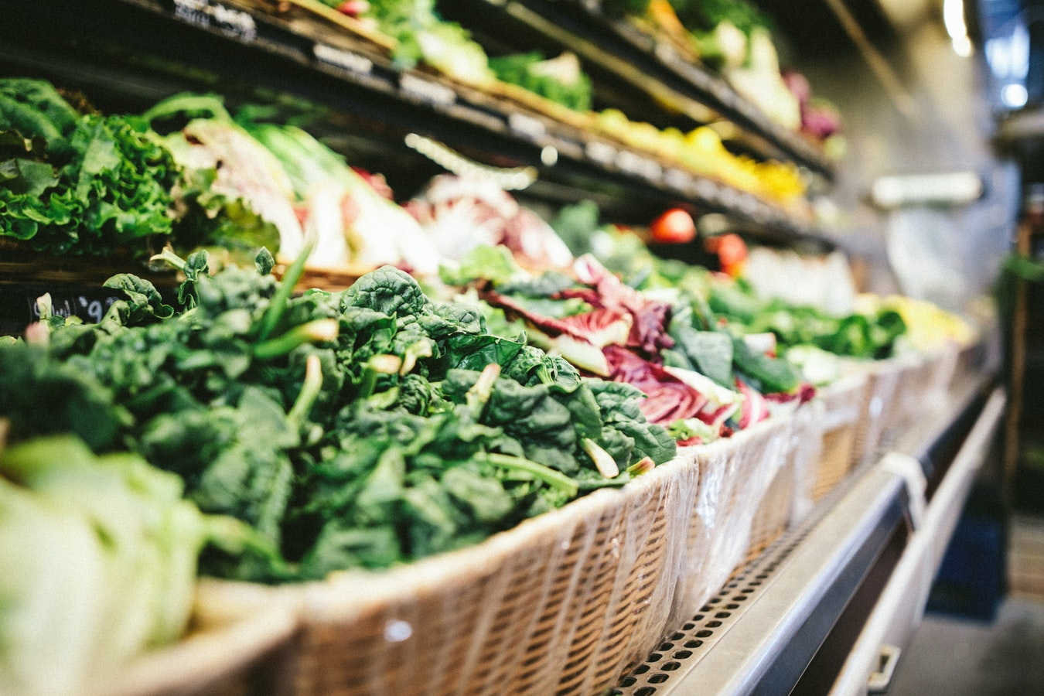
WHAT IS THE DISADVANTAGE OF ORGANIC FOOD?

Slide 13
It can be difficult to find
Organic foods tend to be seasonal
The most common complaint though is that organic food is too expensive

Slide 14
Denver, Colorado (Organic Farm)

Slide 15
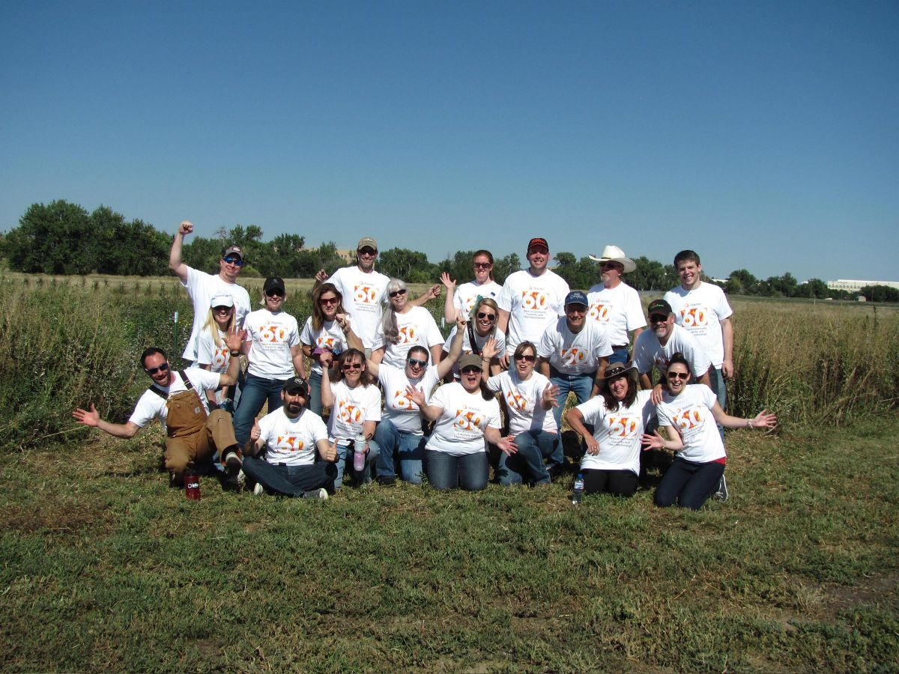
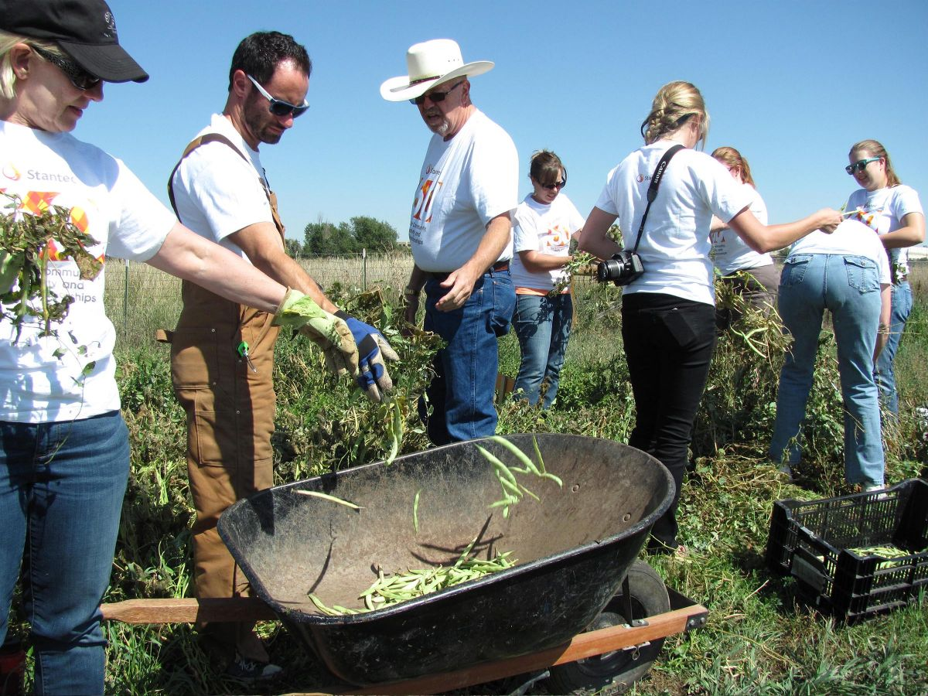

Slide 16
